Slide 1
COMP / IT 420 Lecture 8 Transactions and Concurrency 1
March 22nd, 2021

Slide 2
Class Management
Database project part 2 is due tomorrow, Tuesday, March 23rd at 11:59pm
Grading is now caught up.
Schedule for the rest of class…

Slide 3
Schedule
Week 8: Transactions and Concurrency 1 (Lab) (HW3 out)
Week 9: Database Connectivity (No lab due to César Chávez Day)
Week 10: Transactions and Concurrency 2 (Lab) (HW4 out)
Week 11: NoSQL 1 (Document Stores) (Lab)
Week 12: NoSQL 2 (Graph Stores) (EC: HW5 out) (Lab)
Week 13: Optimization (Lab)
Week 14: Administration and Security (EC: Lab)
Week 15: Final Review and Project Presentations
Week 16: Final Exam (5/19 at 8:00am) Projects Due 5/23 at 11:59pm

Slide 4
Lab on Wednesday
Setting up remote MySQL servers on CIKeys
Transactions Lab

Slide 5
Learning Objectives
Properties of database transactions
Concurrency control
Locking
Will continue in Week 9 after spring break! Woo!

Slide 6
Transaction
Logical unit of work that must be entirely completed or aborted (All or nothing)
Includes:
SELECT statement(s) (Read)
Series of related UPDATE statements (Write)
Series of INSERT or DELETE statements (Write)
Combination of SELECT, UPDATE, INSERT or DELETE statements
More simply organized into READs and WRITEs

Slide 7
Transaction
Must begin with the database in a known consistent state to ensure consistency
Consistent database state: All data integrity constraints are satisfied
Formed by two or more database requests
Database requests: Equivalent of a single SQL statement in an application program or transaction

Slide 8
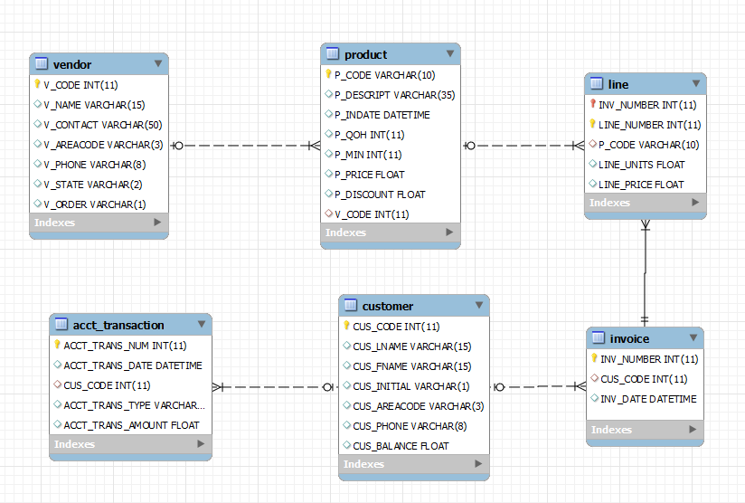
SALECO Transaction
What database changes occur when James Brown orders 9 “Hicut chain saw, 16 in.”?

Slide 9
SALECO Transaction
Create a new purchase invoice
Create a new line in the new invoice for saw
Compute the new product inventory (remove 9 saws)
Bill James by increasing his balance owed

Slide 10
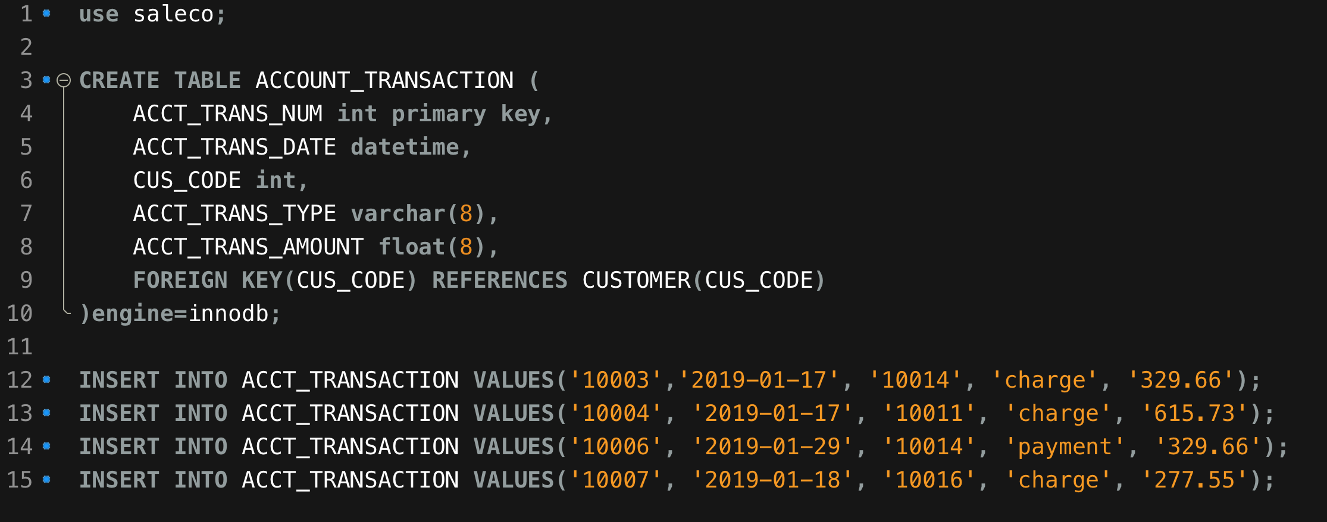
ACCT_TRANSACTION

Slide 11
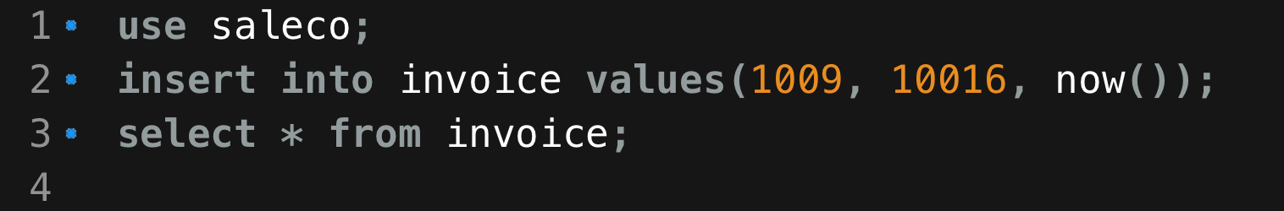
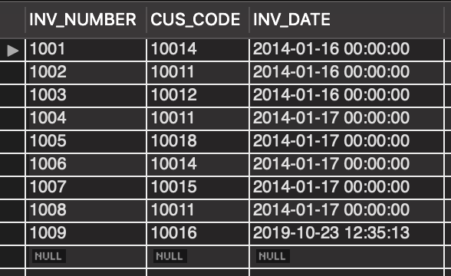
New Invoice is Created

Slide 12
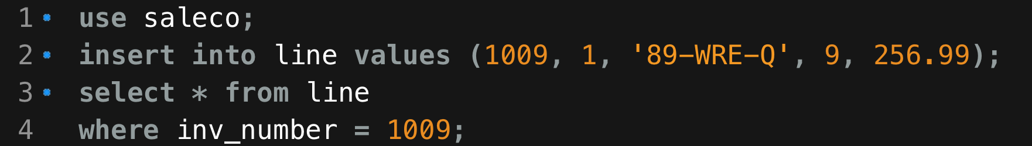
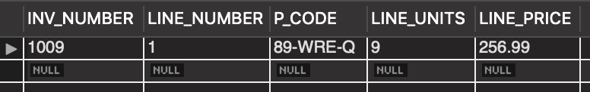
New Line Item is Created

Slide 13
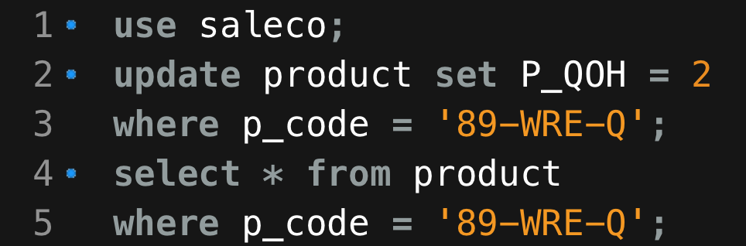
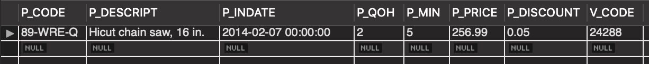
PROD_QOH -= LINE_UNITS

Slide 14
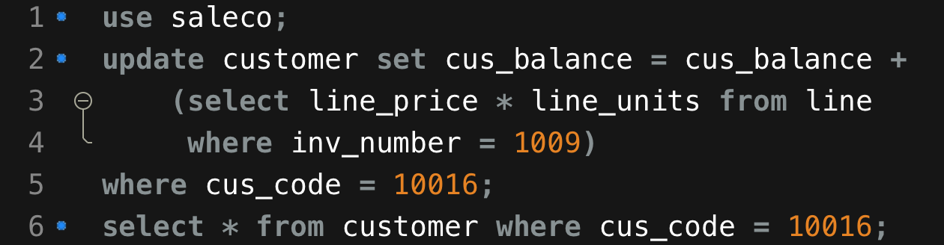
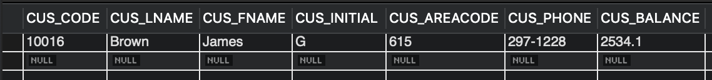
CUS_BALANCE += LINE_PRICE * LINE_UNITS

Slide 15
Atomicity
All operations in a transaction MUST be completed.
If an operation fails,
cancel the entire transaction

Slide 16
Atomicity in SaleCo Transaction
If a successful product purchase has been made, inventory will be reduced and James Brown’s balance will increase. (All or nothing)

Slide 17
Consistency
Guarantees that a transaction leave the database in a consistent state. (Transacts from a consistent state to a consistent state.)
“Consistent” is defined by the DBMS based on rules for data integrity.
If consistency is not preserved, cancel transaction.

Slide 18
Consistency in SaleCo Transaction
James Brown’s balance and SALECO’s QOH are modified based on predefined rules such as taxes and shipping and qty * price

Slide 19
Isolation
Each transaction is atomic as viewed from other transactions.
Data used during the execution of a transaction (T1) cannot be used by another transaction (T2) until the first transaction (T1) is completed.
From the perspective of T2, T1 occurred and completed before T2 (regardless of their potential overlapping).

Slide 20
Isolation in SaleCo Transaction
Future queries should not see James Brown’s balance increased or SALECO QOH reduced until the transaction is complete (i.e. committed).

Slide 21
Durability
Guarantees that data cannot be lost after the completion of a transaction.
Note that this is more malleable for some NoSQL schemes, particularly wide column stores.

Slide 22
Durability in SaleCo Transaction
Once a purchase is complete, James Brown’s balance or SALECO’s QoH do not not revert back to their pre-purchase amounts.

Slide 23
Transaction Properties (ACID)
Atomicity
All operations of a transaction must be completed
If not, the transaction is aborted
Consistency
Follows the predefined rules of the database
Isolation
Data used during transaction cannot be used by second transaction until the first is completed
Durability
Ensures that once transactions are committed, they cannot be undone or lost
Serializability
Ensures that the schedule for the concurrent execution of several transactions should yield consistent results

Slide 24
Transaction Management with SQL
SQL statements that provide transaction support
START TRANSACTION
COMMIT (Write to DB file)
ROLLBACK (Undo all changes prior to last COMMIT)
Transaction sequence must continue until:
1. COMMIT statement is reached
2. ROLLBACK statement is reached
3. End of program is reached
4. Program is abnormally terminated

Slide 25
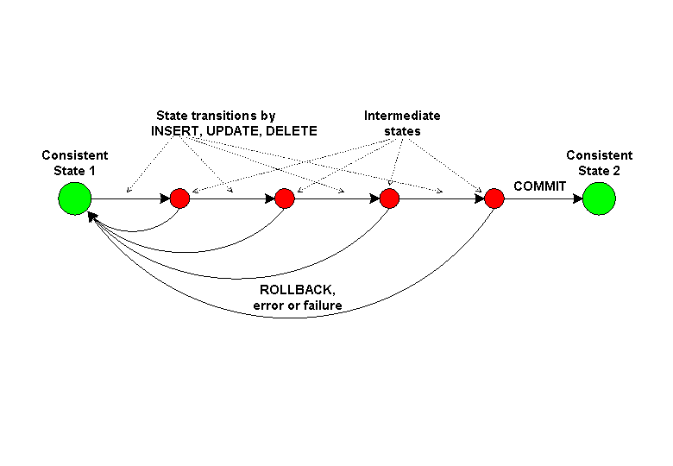
DB State Transition

Slide 26
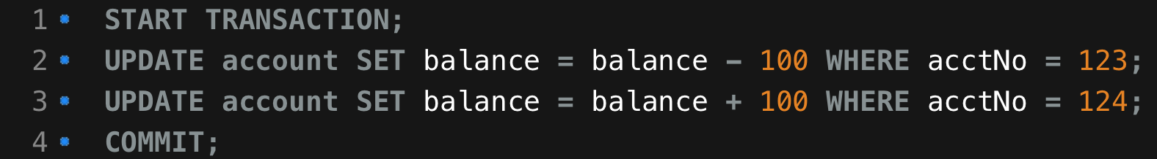
Transactions in MySQL
To successfully transfer money, use the START TRANSACTION and COMMIT commands:
The database is not updated until the COMMIT command is executed

Slide 27
Implicit Transactions in MySQL
InnoDB supports transactions
MyISAM does not support transactions
MySQL runs by default with auto-commit enabled.
Each MySQL statement is treated as a single transaction, with an implicit COMMIT at the end.

Slide 28
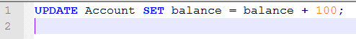
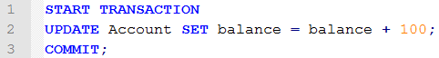
Implicit Transactions in MySQL
is the same as

Slide 29
The Transaction Manager
The transaction manager enforces the ACID properties
Manager schedules the operations of transactions
COMMIT and ROLLBACK are used to ensure atomicity
Locks or timestamps are used to ensure consistency and isolation for concurrent transactions
A log is kept to ensure durability in the event of system failure

Slide 30
COMMIT and ROLLBACK
COMMIT signals the successful end of a transaction
Changes made by the transaction are saved to disk
Changes are now visible to other transactions
ROLLBACK signals the unsuccessful end of a transaction
Changes made by the transaction are undone as if the transaction never happened

Slide 31
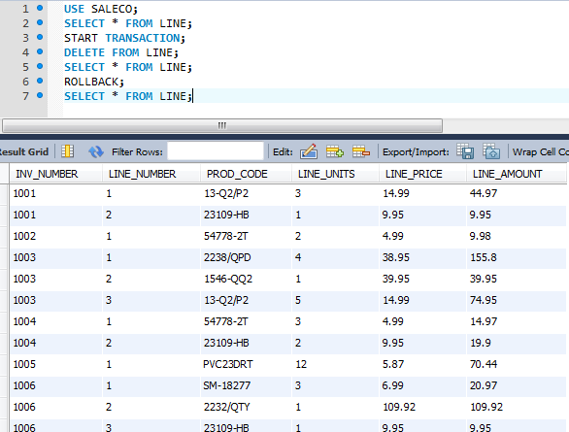
BEFORE DELETE

Slide 32
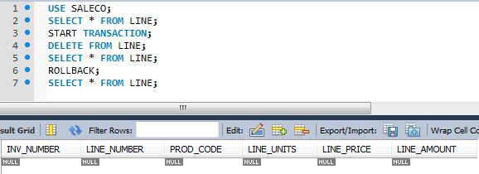
AFTER DELETE

Slide 33
AFTER ROLLBACK

Slide 34
Concurrency Control
Coordination of simultaneous transactions executed in a multiuser database system
Ensures serializability of transactions in a multiuser database environment
Pessimistic: Don’t allow for bad things to happen
Optimistic: Bad things won’t happen that often, so commit first and ask questions later

Slide 35
Simplest “Concurrent” System
Only one transaction at a time
Single database file on disk
How to handle updates to the database?
Make a copy of the whole database
Change the copy
Copy it back if transaction successful
Otherwise, delete copy
Why is this probably not feasible at scale?

Slide 36
Problems in Concurrency Control
Lost updates due to concurrent transactions overwriting each other
Uncommitted data due to transaction using data from another cancelled transaction
Inconsistent Retrievals occur when a transaction accesses data before and after one or more transactions finish working with such data.

Slide 37
Dummy Transactions
Transaction 1 | Transaction 2
Read (A)
Write (A)
 | Read (A)
 | Write (A)
Read (B)
Write (B)
 | Read (B)
 | Write (B)
COMMIT | COMMIT
TIME
Database Objects (A, B, etc.)
Read
Operation that retrieves information from the database (select)
Write
Operation that modifies information in the database (update, insert, delete)

Slide 38


T1 and T2

Slide 39
Lost Updates
Transaction 1 | Transaction 2
START | START
Read (A) A=20
 | Read (A) A=20
Write(A) A+=5
 | Write(A) A+=10
COMMIT | COMMIT
What is the value of A after both transactions complete?
What should it be for consistency?
What happened?
Lost update due to overwrite, T2 writes before T1 commits

Slide 40
Read on Uncommitted Data
What is the current value of A?
What should be the current value of A?
What happened?
T2 read uncommitted data from T1 and made an inconsistent write
Transaction 1 | Transaction 2
START (A=10) | START
Write (A) A = 20
 | Read (A) A = 20
 | Write (A) A +=5
ROLLBACK
 | COMMIT

Slide 41
Inconsistent Retrieval
What happened?
Inconsistent retrieval of average of P
Also write of uncommitted data
Transaction 1 | Transaction 2
START (P=[]) | START
Write (P) P = [1]
Write (P) P = [1,2] | Read (P) AVG(P)
Write (P) P = [1,2,3]
COMMIT | WRITE (Q) Q = AVG(P)
 | COMMIT

Slide 42
Serializability
Ensures consistency of concurrent transaction execution.
That is, if you have a series of transactions occurring simultaneously, they do not result in an inconsistent database state (with regards to their explicit operations)*.
*errors of semantics, like user error or incorrect statements, are still possible

Slide 43
The Scheduler
Establishes the order in which the operations are executed within concurrent transactions
Interleaves the execution of database operations to ensure serializability and isolation of transactions

Slide 44
The Scheduler
Based on concurrency control algorithms to determine the appropriate order
Creates serialization schedule
Serializable schedule: Interleaved execution of transactions yields the same results as the serial execution of the transactions

Slide 45
Conflict Serializability
T1 Read (A)
T2 Read (A)
order matter?
T1 Write (A)
T2 Read (A)
order matter?
T1 Read (A)
T2 Write (A)
order matter?
T1 Write (A)
T2 Write (A)
order matter?
Conflict is when there are two operations on the same data item
and one is a write operation

Slide 46
Conflict Serializability
T1 Read (A)
T2 Read (A)
No conflict
T1 Write (A)
T2 Read (A)
Write-Read Conflict
T1 Read (A)
T2 Write (A)
Read-Write Conflict
T1 Write (A)
T2 Write (A)
Write-Write Conflict
Conflict is when there are two operations on the same data item
and one is a write operation

Slide 47
Unrepeatable Read
Read-Write Conflict
T1 gets two different values for A in the same transaction which breaks isolation
Transaction 1 | Transaction 2
START (A=10) | START
Read (A) A = 10
 | Read (A) A = 10
 | Write (A) A +=5
Read (A) A = 15
COMMIT | COMMIT

Slide 48
Read on Uncommitted Data
Write-Read Conflict
T2 reads A with uncommitted value
Also known as a ”dirty read”
Transaction 1 | Transaction 2
START (A=10) | START
Write (A) A = 20
 | Read (A) A = 20
 | Write (A) A +=5
ROLLBACK
 | COMMIT

Slide 49
Overwriting Uncommitted Data
Write-write conflict
T2 overwrites A
T1 overwrites B
Transaction 1 | Transaction 2
START (A=10) | START
Write (A) A = 20
 | Write (A) A = 30
 | Write (B) B = ‘Ant’
Write (B) B = “Dog”
COMMIT | COMMIT

Slide 50
Transaction 1 | Transaction 2
Read (A)
Write (A)
 | Read (A)
 | Write (A)
Read (B)
Write (B)
COMMIT
 | Read (B)
 | Write (B)
 | COMMIT
Example pulled from CMU Database Systems Fall 2019 – Lecture 16

Slide 51
Transaction 1 | Transaction 2
Read (A)
Write (A)
 | Read (A)
Read(B)
 | Write(A)
Write (B)
COMMIT
 | Read (B)
 | Write (B)
 | COMMIT

Slide 52
Transaction 1 | Transaction 2
Read (A)
Write (A)
Read(B)
 | Read(A)
 | Write(A)
Write (B)
COMMIT
 | Read (B)
 | Write (B)
 | COMMIT

Slide 53
Transaction 1 | Transaction 2
Read (A)
Write (A)
Read(B)
 | Read(A)
Write(B)
 | Write(A)
COMMIT
 | Read (B)
 | Write (B)
 | COMMIT

Slide 54
Transaction 1 | Transaction 2
Read (A)
Write (A)
Read(B)
Write(B)
 | Read(A)
 | Write(A)
COMMIT
 | Read (B)
 | Write (B)
 | COMMIT

Slide 55
Transaction 1 | Transaction 2
Read (A)
Write (A)
Read(B)
Write(B)
 | Read(A)
 | Write(A)
COMMIT
 | Read (B)
 | Write (B)
 | COMMIT
Transaction 1 | Transaction 2
Read (A)
Write (A)
Read(B)
Write(B)
COMMIT
 | Read(A)
 | Write(A)
 | Read (B)
 | Write (B)
 | COMMIT

Slide 56
Conflict Equivalent – Two schedules result in same state
Transaction 1 | Transaction 2
Read (A)
Write (A)
 | Read (A)
 | Write (A)
Read (B)
Write (B)
 | Read (B)
 | Write (B)
COMMIT | COMMIT
Transaction 1 | Transaction 2
Read (A)
Write (A)
 | Read (A)
Read (B)
 | Write (A)
Write (B)
 | Read (B)
 | Write (B)
COMMIT | COMMIT
A = 20
A = 20
A += 5
A += 5
A = 25
A = 25
A -= 10
B = 5
B = 5
A -= 10
B *= 2
B *= 2
B = 10
B = 10
B -= 10
B -= 10
A = 15 B = 0
A = 15 B = 0

Slide 57
Conflict Serializable – Conflict equivalent with serial schedule
Transaction 1 | Transaction 2
Read (A)
Write (A)
 | Read (A)
 | Write (A)
Read (B)
Write (B)
COMMIT
 | Read (B)
 | Write (B)
 | COMMIT
Transaction 1 | Transaction 2
Read (A)
Write (A)
Read(B)
Write(B)
COMMIT
 | Read(A)
 | Write(A)
 | Read (B)
 | Write (B)
 | COMMIT

Slide 58
Not conflict serializable!
No way to make it equivalent to a serial ordering due to inability to change the order of writes on A.
Transaction 1 | Transaction 2
START | START
Read (A)
 | Read (A)
 | Write (A)
Write(A)
COMMIT | COMMIT

Slide 59
Precedence Graph
Algorithm to create a directed graph to describe the schedule of operations
Precedence graph S consisting of vertex-edge pairs (V, E)
where V = ( T₀, T₁, …, T_{n} ) or transactions
and E = ( T_{i} → T_{j} ) where an operation O_{i} in T_{i} conflicts with operation O_{j} in T_{j}
and O_{i} appears earlier in schedule than O_{j}
Conflict serializable if-and-only-if graph S is acyclic. Whew…

Slide 60
T_{i}
T_{j}
Connect transaction i (T_{i}) to transaction j (T_{j}) in precedence graph S if:
T_{i} writes (O_{i}) to object A before T_{j} executes a read (O_{j}) on object A
T_{i} reads (O_{i}) an object A before T_{j} executes a write (O_{j}) to object A
T_{i} writes (O_{i}) to object A before T_{j} executes a write (O_{j}) to object A

Slide 61
Transaction 1 | Transaction 2
Read (A)
Write (A)
 | Read (A)
 | Write (A)
 | Read (B)
 | Write (B)
 | COMMIT
Read (B)
Write (B)
COMMIT
T₁
T₂
Cycle in graph, so NOT conflict serializable.
Because output of T₁ depends on T₂ and output
of T₂ depends on output of T₁

Slide 62
Transaction 1 | Transaction 2
Read (A)
Write (A)
 | Read (A)
 | Write (A)
Read (B)
Write (B)
COMMIT
 | Read (B)
 | Write (B)
 | COMMIT
T₁
T₂
No cycle in graph!
Conflict serializable! Yay!

Slide 63
Puppy!

Slide 64
Concurrency Control with Locking Methods
Concurrency Control is the means used by a DBMS to ensure that the results of concurrent transactions produce a serializable schedule
Locking is a system controlled process that manages concurrent access to shared database resources. There are many different locking and concurrency algorithms
Isolation levels are a means to inform the database of the extent and complexity of the concurrency control it should use in operation

Slide 65
Transaction Isolation Levels
Isolation levels based on permitted types of “reads” used during a transaction
Dirty read is a read of uncommitted data
Nonrepeatable read allows for the same read at two different points in a transaction to return different results
Phantom read allows for a query to return more results depending on when it is run in a transaction

Slide 66
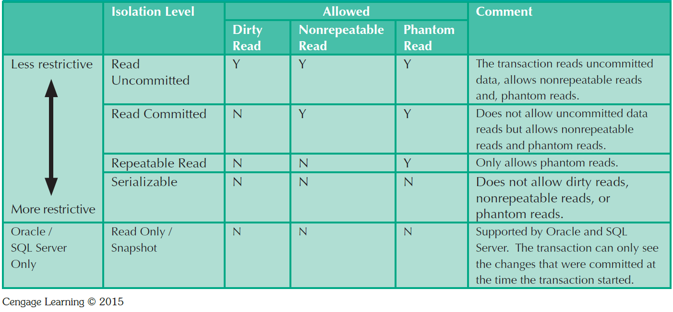
Transaction Isolation Levels
MySQL is “Repeatable Read” by default, which is stricter than others

Slide 67
Lock Granularity
Indicates the level of lock use
Database-level
Table-level
Page-level
Page or diskpage: Directly addressable section of a disk
Row-level
Range lock
Field-level

Slide 68
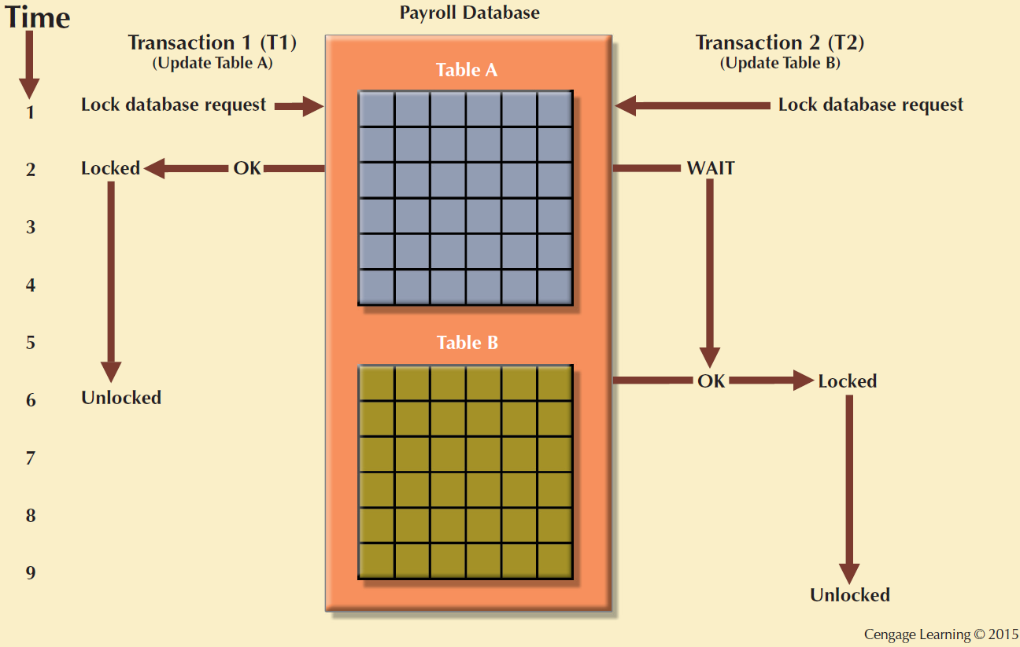
Database-Level Locking Sequence

Slide 69
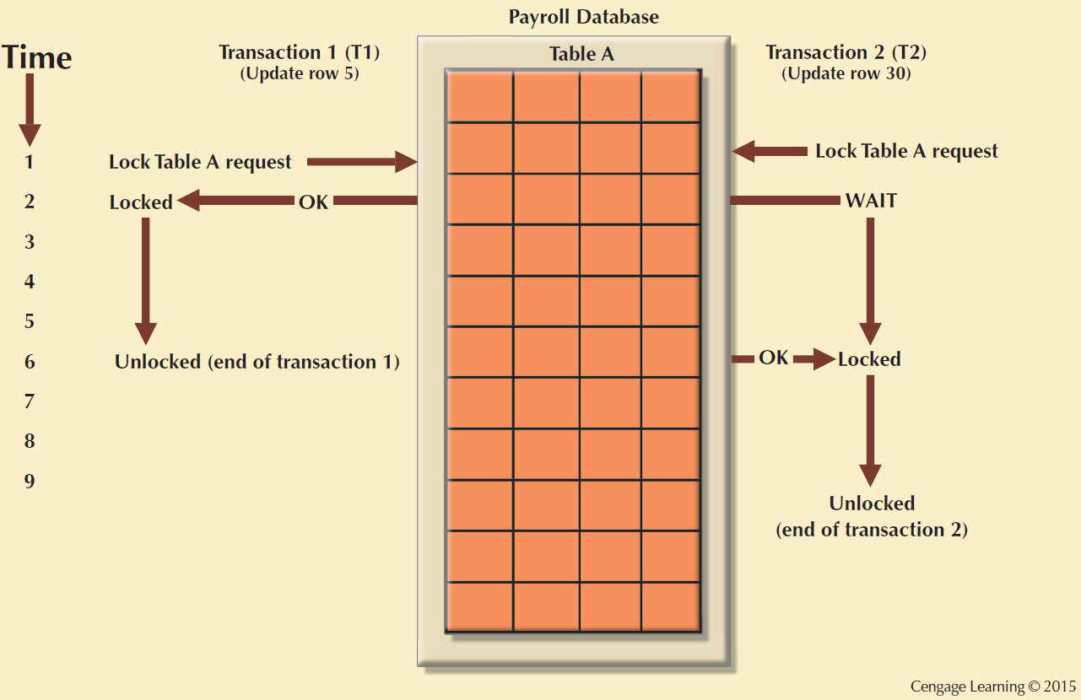
Table-Level Lock

Slide 70
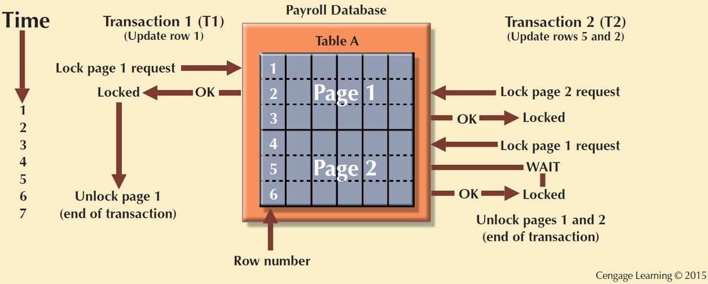
Page-Level Lock

Slide 71
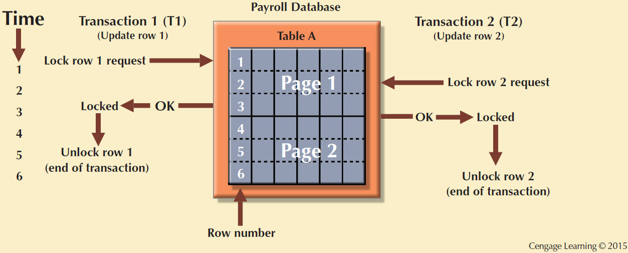
Row-Level Lock

Slide 72
Binary Lock
Has two states: locked (1) and unlocked (0)
If object is locked by a transaction, no other transaction can use that object
If an object is unlocked, any transaction can lock object for use.

Slide 73
Binary Lock
Transaction 1 | Transaction 2
START | START
Lock (A)
Read (A)
Write (A)
Unlock (A)
COMMIT | Lock(A)
 | Read(A)
 | Write(A)
 | Unlock (A)
 | COMMIT
Lock(A) means that transaction acquires a lock on object A
Unlock(A) mean that transaction releases a lock on object A

Slide 74
Exclusive and Shared Locks
Exclusive Lock (or write-lock) refers to when access is reserved for a specific transaction. (Generally when a write is required.)
Shared Lock (or read-lock) is when multiple transactions are granted read access through a common lock.

Slide 75
Problems in Using Locks
Transaction schedule might not be serializable
Deadlocks may occur

Slide 76
Deadlock
Occurs when two transactions wait indefinitely for each other to unlock data
Known as deadly embrace
Control techniques
Deadlock prevention – check on lock acquisition, reschedule
Deadlock detection – periodic check and reschedule
Deadlock avoidance – all locks acquired before execution
Choice of deadlock control method depends on database environment

Slide 77
Deadlock
Transaction 1 | Transaction 2
START | START
Lock (A) | Lock(B)
Lock (B) | Lock(A)
. | .
. | .
. | .
. | .
T1 wants to use A and B for some purpose
T2 wants to use A and B for some purpose
Each grabs a part of the locks they need concurrently and then waits forever

Slide 78
Transaction Isolation and Locks
Read Uncommitted – no locks used
Read Committed – exclusive locks on data
Repeatable Read – shared and exclusive locks
Serializable – prevents phantom reads through range locks on SELECT statements

Slide 79
Stopping Here!
Lab will be on some of the previous concepts.
We will be working on connecting to database remotely as well.
Next week there is no lab session.

